Slide 1
APDs with ultra-thin avalanche region for sensitive X-ray detection
Lucas Pinel
PROMIS Mid-Term Review
London, 7th-8th December 2016

Slide 2
Personal background
Master of Science
in Engineering
Master of Science
in Engineering
Placement
1 paper in Nature Materials
PROMIS secondment
Trans. Electron Microscopy

Slide 3
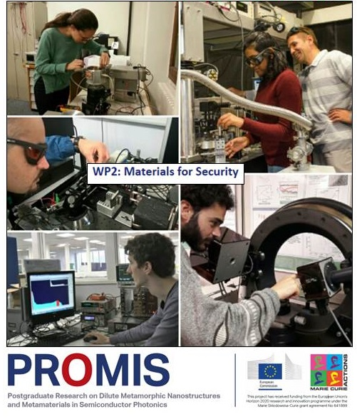
WP2: Materials for security
Objectives: Development of new tools regarding security (X-ray, cryptography)
Collaborating partners:
University of Sheffield, Tyndall,
Sgenia, IDQuantique
ESR 8: Expected outcome:
High resolution shallow pixel
APD X-ray detectors

Slide 4
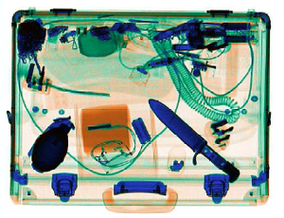
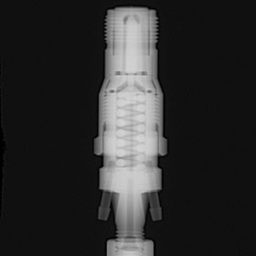
Background on X-ray security
Airport and border security, quality control of materials in industry…
Need for faster, more reliable, cheaper devices

Slide 5
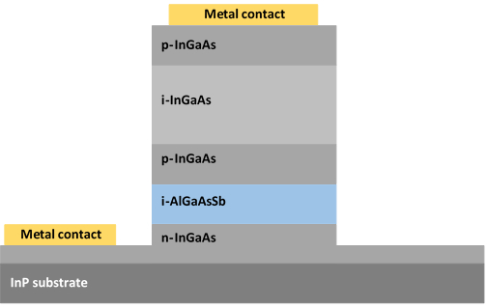
Experimental techniques - Introduction
Using APD as X-ray detector => internal gain, lower noise
Novel InGaAs/Al(Ga)AsSb combination for X-ray detection
Samples grown by
Device fabrication

Slide 6
Experimental techniques – Electrical characterisation
Current-Voltage measurements
Material quality
Leakage mechanisms
Dark current level
Capacitance-Voltage measurements
Electric field profile
Doping levels

Slide 7
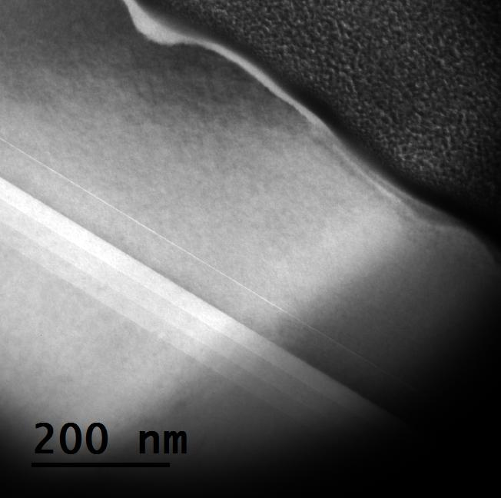
Experimental techniques – Material characterisation
TEM images in
University of Cádiz
Growth of good quality materials, low defects, including in AlGaAsSb
Al_{0.85}Ga_{0.15}As_{0.56}Sb_{0.44}
Grading layers
In_{0.53}Ga_{0.47}As
Sample preparation
and imaging by
F.J. Delgado

Slide 8
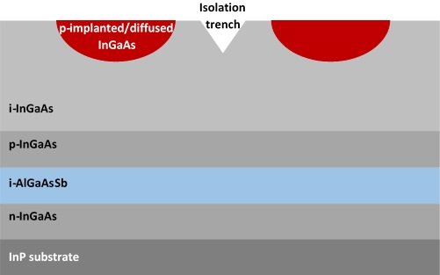
Experimental techniques - Summary
Achievements: good quality materials, working low gain photodiodes
Problems
Solutions
Continue growth and electrical characterisation loop
Doping controllability
Oxidation leading to high dark currents
Investigate planar structures

Slide 9
Skills acquired
Clean room fabrication techniques
Electrical characterisation of devices
TEM techniques and sample preparation

Slide 10
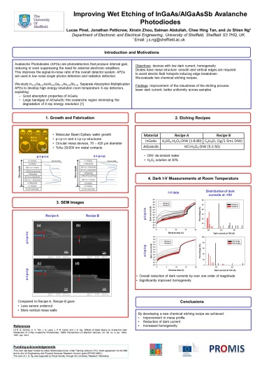
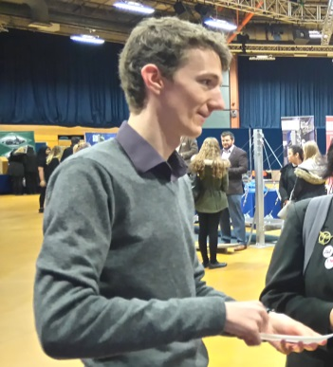
Output within PROMIS
Workshops
Poster at International MBE Conference – Sept. 16
“Improving Wet Etching of InGaAs/AlGaAsSb Avalanche Photodiodes”
Secondment in Universidad de Cádiz (TEM)
Outreach: Photonics stand at STEM for Girls event
in Sheffield, April 2016 (nearly 450 attendees)

Slide 11
Future work and aspiration
Outcome of PROMIS:
Network
Multicultural work experience
Boost on language skills
Aspirations after PROMIS:
Secure a job in R&D in industry

Slide 12
Thank you for your attention! Questions?

